Slide 1
SSN COLLEGE OF ENGINEERING
COURIER MANAGEMENT SYSTEM
-KARTHICK V
-KAUSHIK A
-KARUNAGARAN R
-K.V.HEMASRI
-KAVIN V
-KAVIYAPRIYA K
-KAYATHRI R

Slide 2
INTRODUCTION TO OUR WORK!!
The main motive of the project is to develop an application system that computerize the data maintained in the service system.
A courier delivery management system, or CMS, is business software that simplifies courier management and routing
There are three main objectives of courier management:
Login credentials.
Tracking the status of the parcels
Storing data for the delivered and to be delivered parcels.

Slide 3
PROBLEM STATEMENT
A parcel service office wants to develop a system to manage their dispatch service. The parcel should be assigned a unique tracking number using which the status of the parcel can be tracked. The sender and the receiver address, and contact details have to be maintained in the system. Once the parcel has reached the destination office, the sender and the receiver should be notified. It should be possible to fetch a location and date-wise list of deliveries from the system. Even after completion of the delivery, the system should be able fetch the relevant details using the tracking number.

Slide 4
PROJECT OVERVIEW
Project Name | Courier Management System Project in Python
Abstract | A GUI-based program in python that basically includes the use of the Tkinter and Several data structures for execution of the data
Language/Technologies Used | Python, Tkinter
Python version (Recommended) | 3.8 or 3.9
Type/Category | First year Project using Python
Software used | Jira software an agile project management tool
Staorge of data | In several python Data structures

Slide 5
PROJECT REQUIREMENTS
Unique tracking number for all the parcels as an identification for all the parcels.
The software should store the addresses of both the receivers and the sender of the parcel
Tracking the parcel and notifying the senders and receivers about the status of the parcel
A complete data hub containing the data of all the parcels delivered with appropriate location and date of delivery
Separate data should be maintained for different mode of deliveries

Slide 6
MAJOR MODULES
THERE ARE SOME MAJOR MODULES IN THE PROJECT:
>LOGIN MANAGEMENT
>TRACKING MANAGEMENT
>DATA MANAGEMENT
-location and date-wise list of deliveries from the system

Slide 7
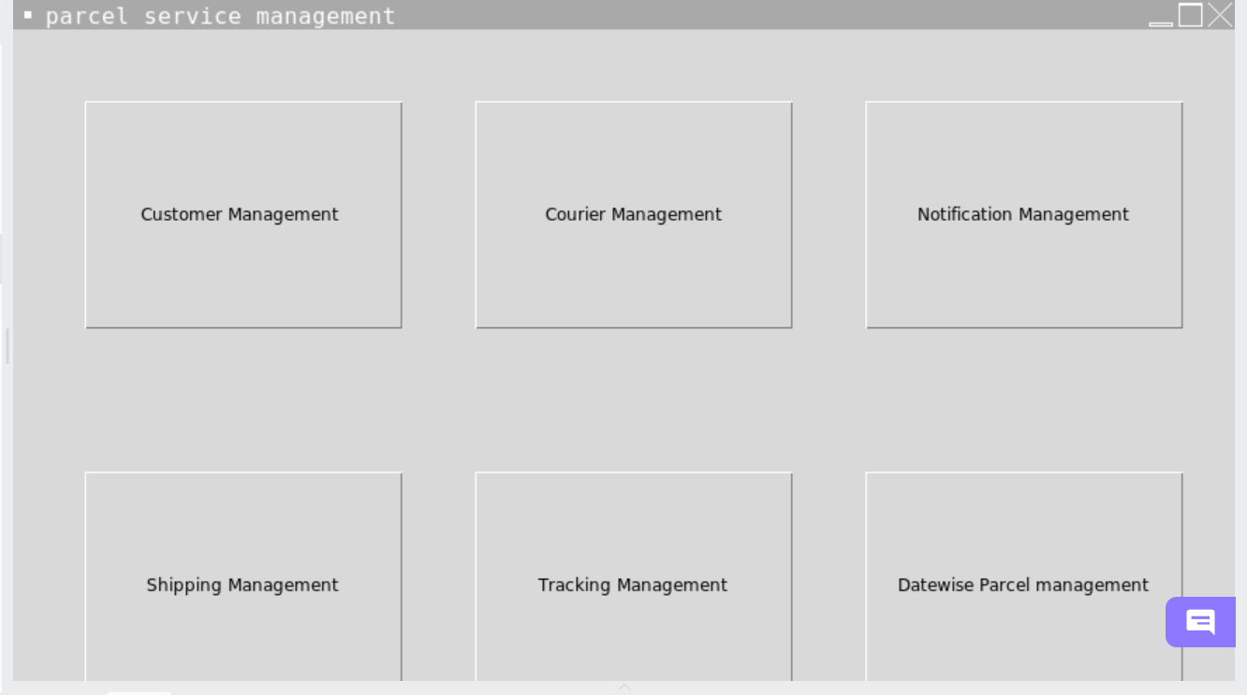
DISPLAY SCREEN

Slide 8
COURIER MANAGEMENT
In this module the user can fetch the information about what type of parcel are available in the searched pincode
Pincodes plays major role in this module
A legible class diagram for this module is attached
It consists of 2 ADT for storing the services and retrieving the data respectively for the searched pincode
The first ADT –stores pincode in an array,next array will contains the services
The second ADT –creates object to store the services in the arrays of list

Slide 9
Continued…..
CLASS RETRIEVE_SERVICES
Self.codes , self.services
Lists(),append(),resize(),
CLASS PINCODES
Place, services_available_time,services_availability
get_place(), get_services_available_time,get_services_available

Slide 10
TRACKING MANAGEMENT
In this module the user can track the status of package using the unique tracking number.
Tracking number plays a crucial role here.
It indicates the current package status during transportation. You may refer to our status definition: Not Found / Info Received / In Transit / Pick Up / Out for Delivery / Undelivered / Delivered / Alert / Expired. When tracking is completed, we will show the status according to all detailed tracking information.

Slide 11
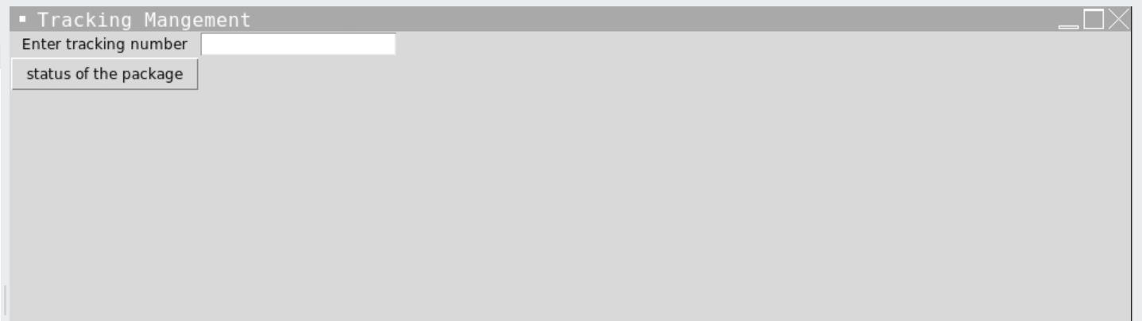
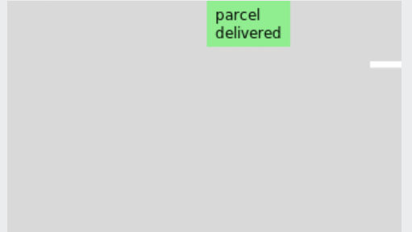
DISPLAY SCREEN

Slide 12
CUSTOMER MANAGEMENT
In this module the customer details including name ,mobile number, email id , sender address , receiver address are collected and stored.
A unique tracking number is generated for each parcel while entering the details.
Using this tracking number the status of the parcel can be tracked later on.
The weight and the mode of the parcel is also taken as input.
The mode of the parcel includes normal delivery, speed day delivery ,overnight.
Based on the weight and the mode of parcel the amount to be collected for the service is generated.

Slide 13
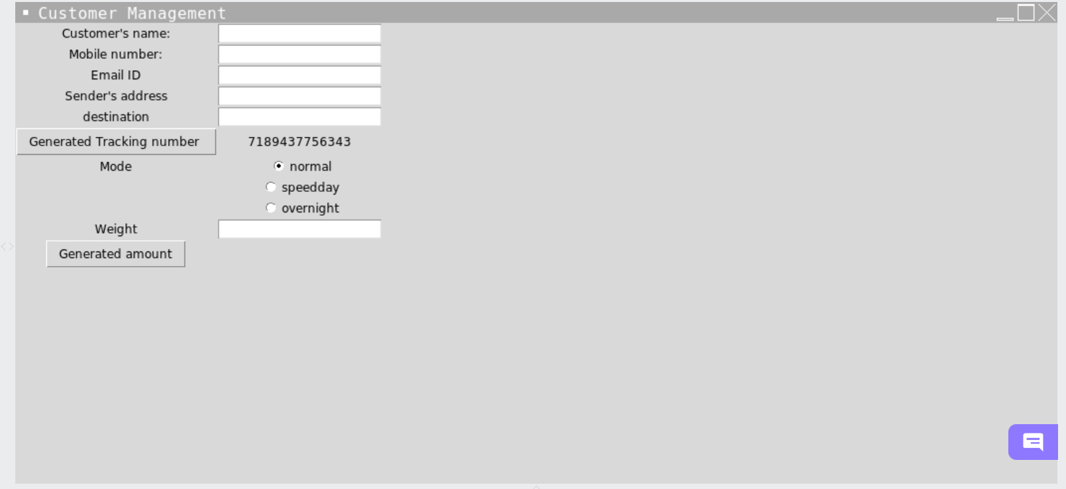
DISPLAY SCREEN

Slide 14
SHIPPING MANAGEMENT
In this module, the user will enter the city’s name to fetch the package details.
Initially the user will be asked to enter the name of the city.
According to the name of the city entered, localities and areas available in that city will be displayed.
Then, the user will have to select the particular locality in which the package details will be found.
Depending upon the locality selected the package details will be displayed.

Slide 15
NOTIFICATION MANAGEMENT
this module useful for the customer To find the order status.
Once the order was placed and then reached the destination office it will send the notification to the sender and the receiver that is”” ORDER SUCCESSFULLY REACHED THE DISTINATIONOFFICE “”
The module is used for multiple purposes.
Delivery notification should make your customer happy.
It is also important to send your customers an email when the order has been delivered. Important information should be included,such as the shipping address.
This will allow customers to confirm that the package was sent to the correct location.Ther is also customer support information like the contact information of the sender.

Slide 16
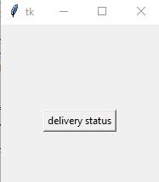
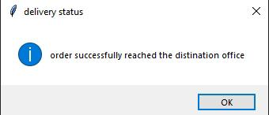
DISPLAY SCREEN

Slide 17
DATE AND TIME MANAGEMENT
In this module the date delivered will be estimated based on the distance calculated between the two place which will be stored in a csv file.
Displaying the current address of the customer, also the address of the order departing from.
Then estimating the time complexity based on the distance from these cities,and also based on other issues .
Now after calculating these complexity date and time will be displayed according to it.
The date is displayed after completing the order and it will be just an estimated time.

Slide 18
THANK YOU

